Slide 1
CHAPTER 3
GETTING HELP IN REDHAT
ENTERPRISE LINUX

Slide 2
Aim:
Use the man Linux manual reader.
Use the pinfo GNU Info reader.
Use the Red Hat Package Manager ( RPM ) package documentation.
Use the red hat - support-tool command.

Slide 3
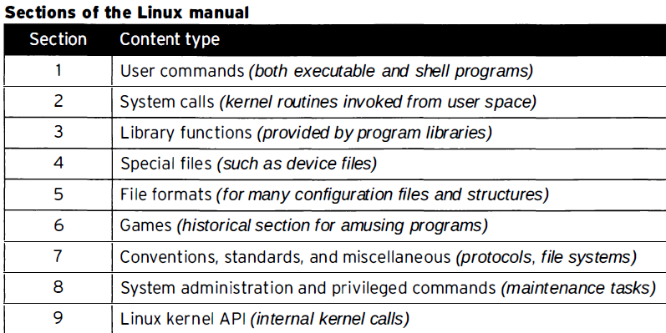
man command

Slide 4
To distinguish identical topic names in different sections , man page references include the section number in parentheses after the topic.
For example, passwd(1) describes the command to change passwords,
while passwd (5) explains the /etc/passwd file format for storing local user accounts.

Slide 5
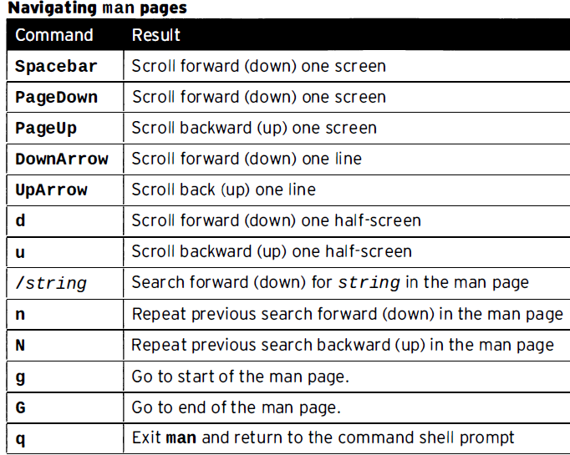

Slide 6
Searching for man pages by keyword
Linux command line provides the documentation for almost all command line tools.
These documents are known as man pages, and you can easily access them through the command line using the man command.

Slide 7
Searching for man pages by keyword
the syntax of this command:
man [command/tool name]
How to make man display manual page from specific sections?
man [section-num] [command/tool name]
For example:
man 3 mkdir

Slide 8
Searching for man pages by keyword
How to make man display all manual pages for a given input?
if you want man to display one by one all manual pages corresponding to a given input, use the -a command line option for it.
For example, if you want to serially view all man pages for 'printf’:
man -a printf
The above command will first open the printf man page from section 1, and when you quit it, the command will ask you if you want to view the next 'printf' man page.

Slide 9
Searching for man pages by keyword
How to make man search considering input as regular expression?
In case you want the man command to search and list manual pages by considering input as a regular expression, you can do that using the -k command line option.
man –k [command]
Syntax:
man -K [command/tool name]
For example:
man -K printf
// Full text page search

Slide 10
Searching for man pages by keyword
How to make man display location of manual pages?
In case the requirement is to only know the location of manual pages, you can force man to do this by using the -w command line option.
Syntax:
man -w [command/tool name]
For example:
man -w printf

Slide 11
Searching for man pages by keyword
How to make man display manual pages in Web browser?
Use the -H command line option for this.
man -H[browser-command] [command/tool name]
For example:
man -Hfirefox printf
Or
man --html=firefox <command>

Slide 12
Searching for man pages by keyword
How to make man command case sensitive?
By default, the man command ignores case while searching for manual pages.
However, if you want, you can enable case-sensitivity using the -I command line option.
man -I [command/tool name]

Slide 13
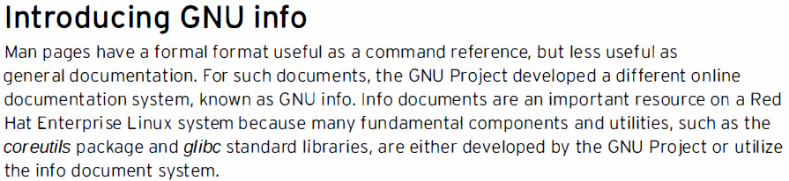
Reading Documentation Using pinfo Command

Slide 14
Reading Documentation Using pinfo Command
You can specify which page you want to read by passing it as an infopage argument.
This argument contains the name of an info page.
The program will then search for it in the current directory, /usr/share/info, /usr/info, /usr/local/share/info, /usr/local/info. and /opt/info.

Slide 15
Reading Documentation Using pinfo Command
The search path can be adjusted by INFOPATH environment variable or in the configuration file.
Info documentation is structured as hyperlinked info nodes. This format is more flexible than man pages, allowing thorough discussion of complex commands and concepts.
info nodes are read from the command line, using either the info or pinfo commands.

Slide 16
Reading Documentation Using pinfo Command
To install pinfo, you can use the following command.
sudo yum install pinfo
OR
sudo dnf install pinfo
Try:
pinfo ls
man ls

Slide 17
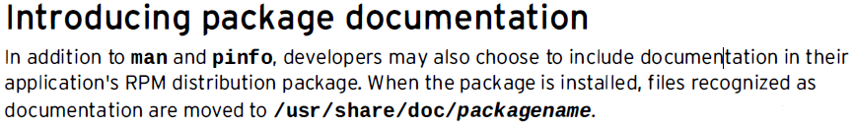
Reading Documentation in /usr/share/doc
Should be able to research information using Red Hat Package Manager documentation

Slide 18
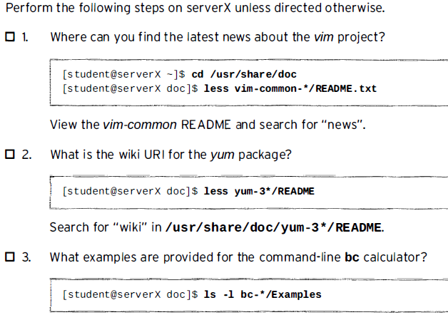
Exercise:

Slide 19
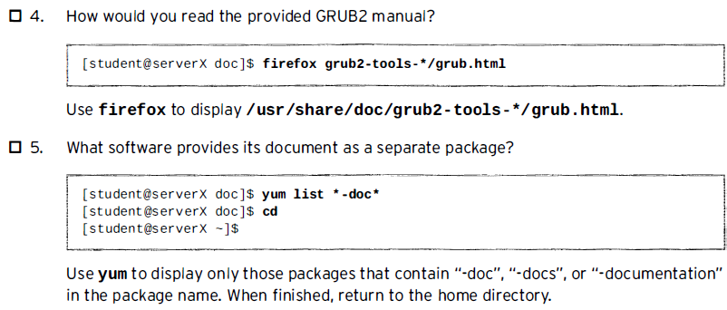
Exercise:

Slide 20
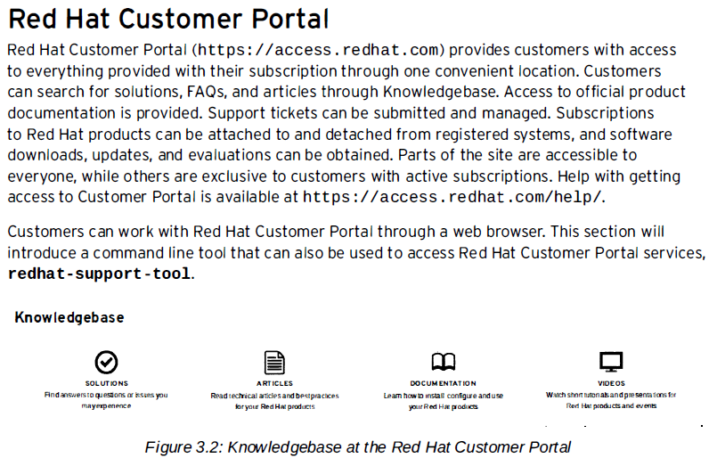
4. Getting Help From Red Hat

Slide 21
4. Getting Help From Red Hat

Slide 22
4. Getting Help From Red Hat
Installation
The Red Hat Support Tool for Red Hat Enterprise Linux is installed by running the following command.
yum install redhat-support-tool

Slide 23
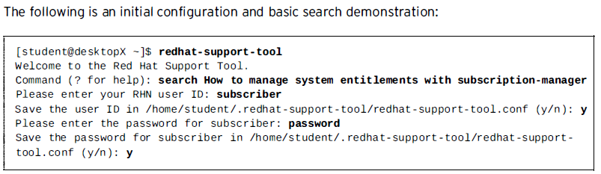
4. Getting Help From Red Hat

Slide 24
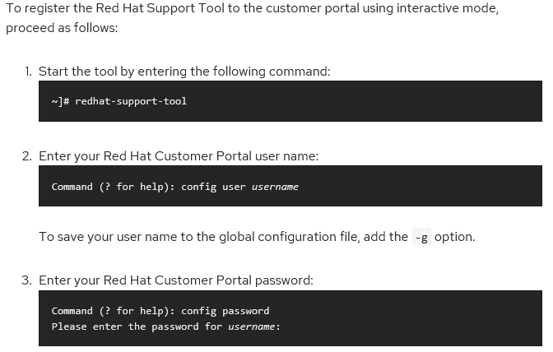
4. Getting Help From Red Hat

Slide 25
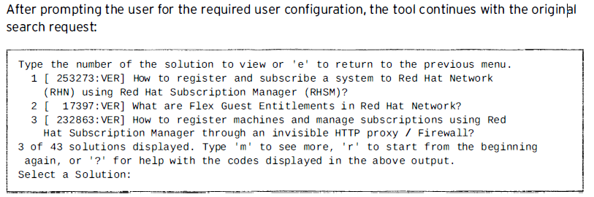
4. Getting Help From Red Hat

Slide 26
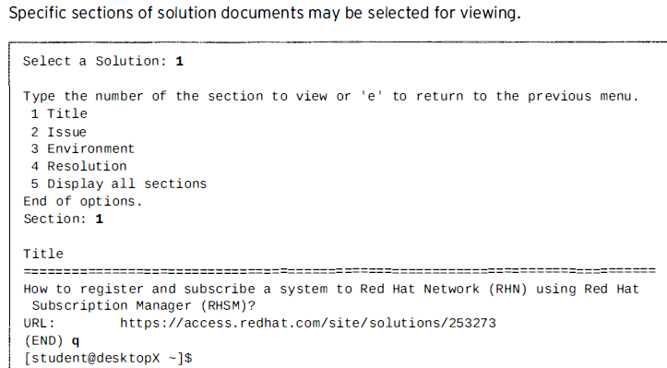
4. Getting Help From Red Hat

Slide 27
4. Getting Help From Red Hat
Directly access Knowledge base articles by document ID
Locate online articles directly using the tool’s kb command with the Knowledge base document
ID.
Returned documents scroll on the screen without pagination, allowing a user to redirect the output using other local commands.

Slide 28
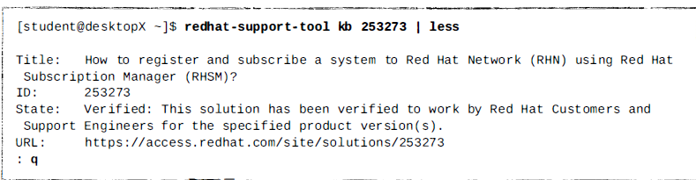
4. Getting Help From Red Hat
This example views the document with the less command:

Slide 29
Working with users and Groups

Slide 30
Working with users and Groups
Manage users and group
Manage ownership, permissions, and quotas

Slide 31
Manage users and group
Linux user accounts
Linux groups

Slide 32
Linux user accounts
How Linux user accounts work
Where Linux user accounts are stored
Creating and managing user accounts from the command line

Slide 33
How Linux User Accounts Work
Username
Password
By default, all user home directories are created and maintained in the /home
  directory.
However, the root user’s home directory is /root

Slide 34
To view information about the user_name account on my Linux system, you would enter finger user_name
The following information about the user account:
Login This is the username that is used to authenticate to the system.
Name This is the user’s full name.
Directory This is the user’s home directory.
Shell This is the default shell that will be provided to the user.
Last Login This displays the last time the user logged in and where from.

Slide 35
Local option
/etc/passwd This file contains the user account information for your system.
/etc/shadow This file contains passwords for your user accounts.
/etc/group This file contains your system’s groups.

Slide 36
- The /etc/passwd File
Username:Password:UID:GID:Full_Name:Home_Directory:Default_Shell
Username: The Username field simply identifies the username the user will supply when logging in to the system
Password: This is a legacy field. At one time, the user’s password was stored in encrypted form in this field in the passwd file. However, for security reasons, the password has been moved from /etc/passwd to /etc/shadow.

Slide 37
UID This is the user ID for the user account
GID This field references the group ID number of the user’s default group
Full_Name This field contains the user’s full name
Home_Directory This field contains the path to the user’s home directory.
Default_Shell This field specifies the shell that will be used by default

Slide 38
- The /etc/shadow File
Username:Password:Last_Modified:Min_Days:Max_Days:Days_Warn:Disabled_Days:Expire
Username This is the user’s login name from /etc/passwd.
Password This is the user’s password in encrypted format
Last_Modified This field displays the number of days since January 1, 1970 that the password was last changed

Slide 39
Min_Days This field displays the minimum number of days required before a password can be changed. In this example, it is set to 0 days.
Max_Days This field displays the maximum number of days before a password must be changed. In this example, it is set to 99999 days. Effectively, this means a password isn’t required.
Days_Warn This field displays the number of days prior to password expiration that the user will be warned of the pending expiration. In this case, it’s set to 7 days.

Slide 40
Disabled_Days This field displays the number of days to wait after a password has expired to disable the account.
Expire (T/g hết hạn) This field displays the number of days since January 1, 1970 after which the account will be disabled. In this example, it is set to a null value, indicating the account never expires.

Slide 41
To verify your /etc/passwd and /etc/shadow files, you can use the pwck command at the shell prompt. This utility will verify each line in the two files and make sure they are valid. Any errors are reported on the screen.
If, for some reason, the /etc/passwd and the /etc/shadow files were out of synchronization, you could use the pwconv command at the shell prompt to fix the files. This utility will add any missing user accounts from /etc/passwd to /etc/shadow.

Slide 42
Creating and Managing User Accounts from the Command Line
Using useradd
Using passwd
Using usermod
Using userdel

Slide 43
- Using useradd
  Syntax: useradd options username
  ex (options default): useradd ncth
  ncth account is created using the default parameters contained in the following configuration files: /etc/default/useradd
  /etc/login.defs This file contains values that can be used for the GID and UID parameters when creating an account with useradd. It also contains
  defaults for creating passwords in /etc/shadow.

Slide 44
You can also view these default values by entering useradd –D at the shell prompt.
  Options
  –c Includes the user’s full name.
  –e Specifies the date when the user account will be disabled. Format the date as yyyy-mm-dd.
  –f Specifies the number of days after password expiration before the account is disabled. Use a value of –1 to disable this functionality, e.g., useradd –f –1 jmcarthur.
  –g Specifies the user’s default group.

Slide 45
  –G Specifies additional groups that the user is to be made a member of.
  –M Specifies that the user account be created without a home directory.
  –m Specifies the user’s home directory.
  –n Used only on Red Hat or Fedora systems. By default, these systems create a new group with the same name as the user every time an account is created. Using this option will turn off this functionality.
  –p Specifies the user’s password.

Slide 46
  –r Specifies that the user being created is a system user.
  –s Specifies the default shell for the user.
  –u Manually specifies a UID for the user.
  EX: useradd –c “Tommy” ncth1
  useradd –c “Truong Khac Tung” –m –p “tung123” –s “/bin/bash” tktung

Slide 47
- Using passwd
  The passwd utility is used to change an existing user’s password
  You can find out this information using the –S option with passwd. For example, we could enter passwd –S vmk at the shell promp
  Syntax: passwd username

Slide 48
options
  –l Locks the user’s account. This option invalidates the user’s password.
  –u Unlocks a user’s account.
  –d Removes a user’s password.
  –n Sets the minimum number of days required before a password can be changed.
  –x Sets the maximum number of days before a password must be changed.

Slide 49
  –w Sets the number of days prior to password expiration when the user will be warned of the pending expiration.
  –i Sets the number of days to wait after a password has expired to disable the account.

Slide 50
- Using usermod
From time to time, you will need to modify an existing user account. The syntax for usermod is very similar to that used by useradd.
Syntax:
usermod options username

Slide 51
options
–c Edits the user’s full name.
–e Sets the date when the user account will be disabled. Format the date as yyyy-mm-dd.
–f Sets the number of days after password expiration before the account is disabled. Use a value of –1 to disable this functionality.
–g Sets the user’s default group.
–G Specifies additional groups that the user is to be made a member of.

Slide 52
options
–l Changes the username.
–L Locks the user’s account. This option invalidates the user’s password.
–m Sets the user’s home directory.
–p Sets the user’s password.
–s Specifies the default shell for the user.
–u Sets the UID for the user.
–U Unlocks a user’s account that has been locked.

Slide 53
useradd –c “your_full_name” –m –p “your_password” –s “/bin/bash” your_username.
tail /etc/passwd
Create a user account using your system’s default settings by entering useradd abc
Passwd abc -> enter password

Slide 54
- Using userdel
Syntax:
userdel username
ex: userdel ncth

Slide 55
- Using userdel
It’s important to note that, by default, userdel will not remove the user’s home directory from the file system. If you do want to remove the home directory when you delete the user, you need to use the –r option in the command line. For example, entering userdel –r ncth will remove the account and delete her home directory.

Slide 56
Linux Groups
How Linux groups work
Managing groups from the command line

Slide 57
How Linux Groups Work
If your Linux system has been configured to use local authentication, your groups are defined in the /etc/group file. Each record is composed of the following four fields:
Group:Password:GID:Users
Group Specifies the name of the group. In the example above, the name of the group is video.
Password Specifies the group password.

Slide 58
GID Specifies the group ID (GID) number of the group.
Users Lists the members of the group.
As with /etc/shadow, each line in /etc/gshadow represents a record for a single group. Each record is composed of the following fields: Group_Name:Password:Group_Admins:Group_Members

Slide 59
Managing groups from the command line
Using groupadd
Using groupmod
Using groupdel

Slide 60
- Using groupadd
Syntax:
groupadd options groupname
Options:
–g Specifies a GID for the new group.
–p Specifies a password for the group.
–r Specifies that the group being created is a system group.

Slide 61
- Using groupmod
To modify a group, including adding users to the group membership, you use the groupmod utility.
Syntax:
groupmod options group
Options:
–g Changes the group’s GID number.
–p Changes the group’s password.
–A Adds a user account to the group.
–R Removes a user account from the group.

Slide 62
If we wanted to add ncth to the group, we would enter
groupmod –A “ncth” student
at the shell prompt.

Slide 63
- Using groupdel
Syntax:
groupdel group_name
ex: groupdel student

